Slide 1
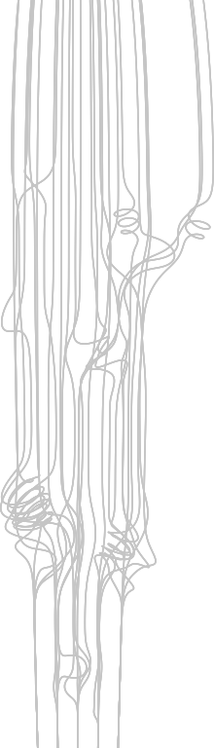

Closed Timelike Curls
ARCH470 | DDS
Özgür Gülsuna
2307668

Slide 2
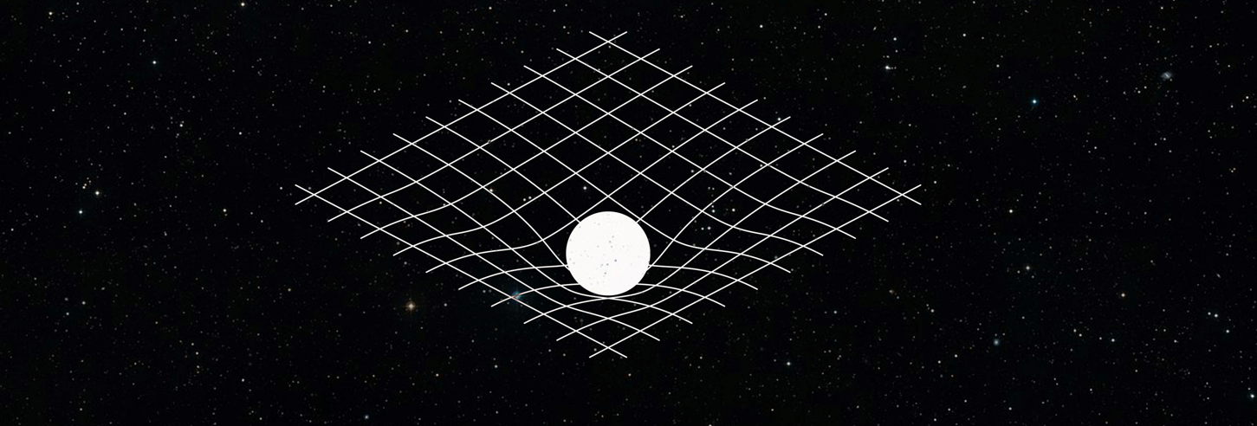
Leverage
Up & Down
t₀ t_{n} t_{m}
It is not about creating something entirely new.
Improving on something that already exist
Gravity

Slide 3
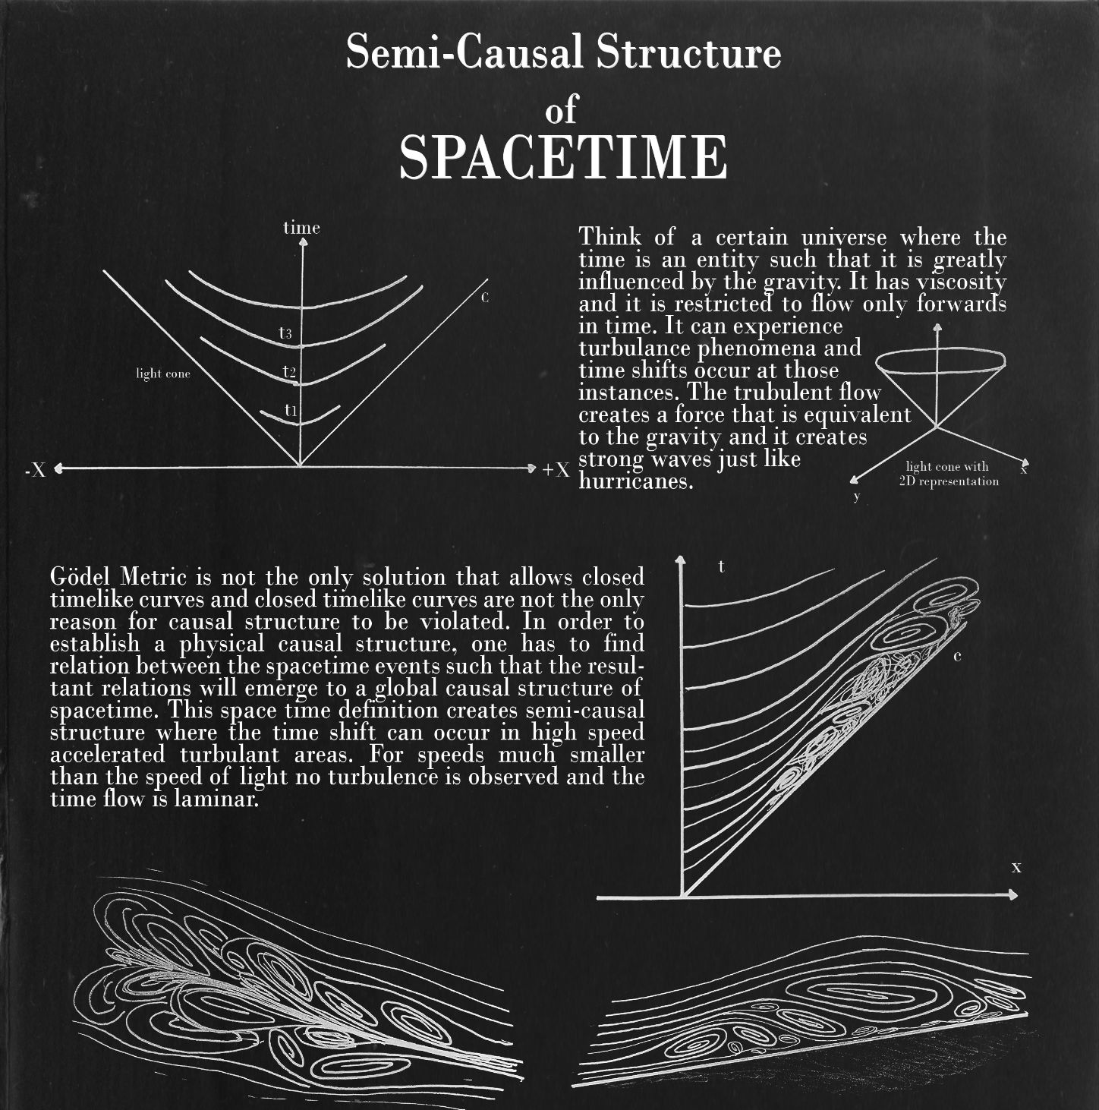

Slide 4
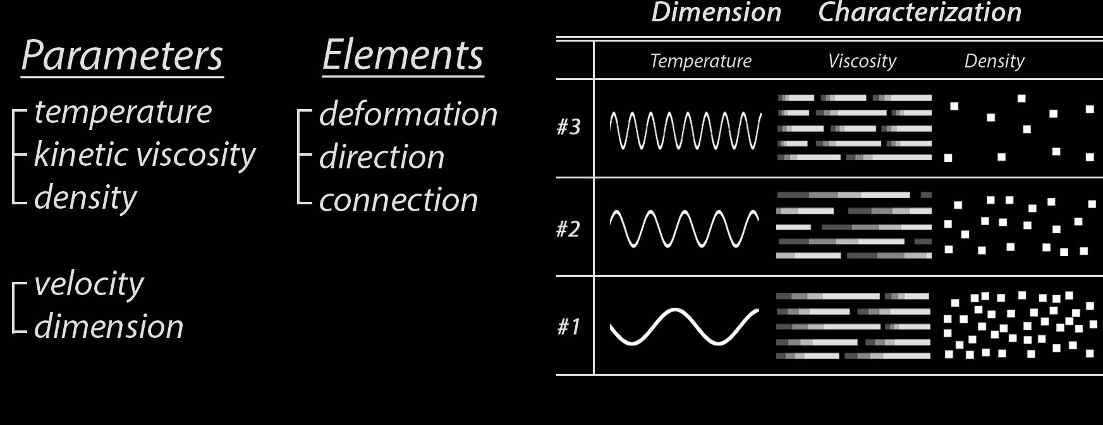

Slide 5
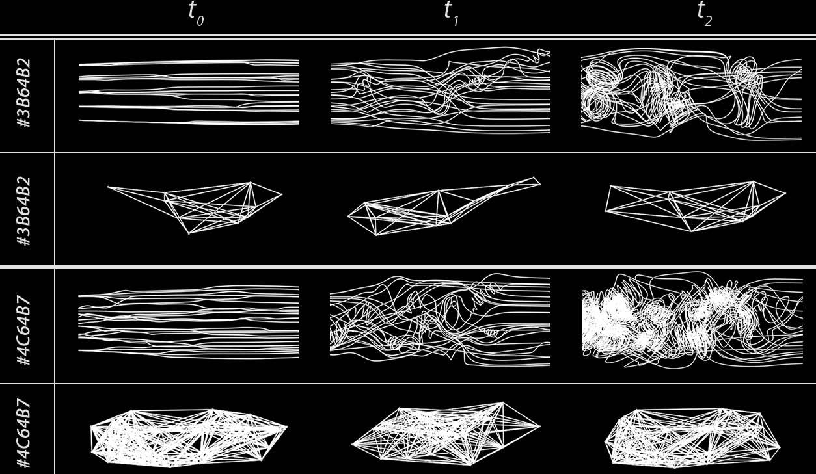

Slide 6
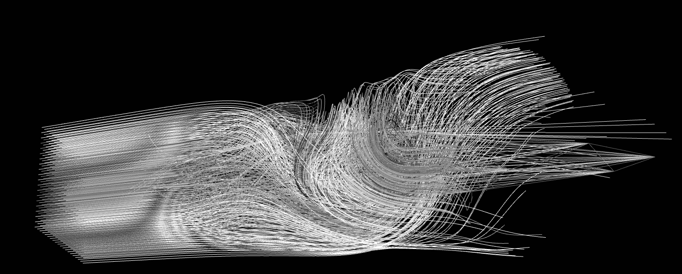
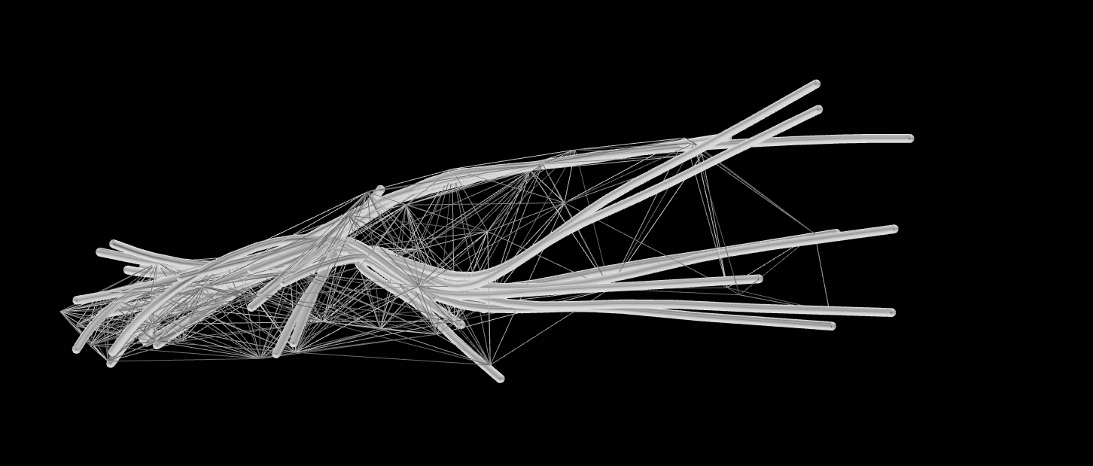

Slide 7
Further Thoughts
How light transport in this medium ?
Relation with matter, how it stretches and deforms.
Time-curvature mirror

Slide 8
Thank you for your time

